Slide 1
ROSE-HULMAN INSTITUTE OF TECHNOLOGY
ROBOTICS TEAM

Slide 2
Team’s PURPOSE
To allow engineering students the opportunity to learn and experience challenging robotic problems.
The Design Process
Teamwork
Network
Hands-on experience
Time management
Improve learned skills
Multidisciplinary
Debugging
Innovate
Fun

Slide 3
Team Structure
Advisors:
Dr. David C Mutchler (Computer Science)
Dr. David Fisher (Mechanical Engineering)
President: Ander Solorzano
Vice-President: Dan Galway
Secretary: Allison Crump
Treasurer: Spencer Carver
MATE
Air
Officers
Competition Teams
IGVC
Kevin Risden (lead)
Software Systems
Ruffin White (lead)
Hardware Systems
Michael Pauly (lead)
Starting this year
Members

Slide 4
MATE
Marine Advance Technology Education (MATE) consists of an international underwater ROV student contest across the U.S, Canada, Scotland, Hong Kong, and Japan.
Competition Characteristics
Sophisticated missions
Critical Thinking
Teamwork
Weight distribution
ROV research

Slide 5
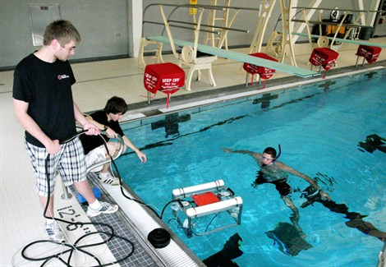
MATE Team Tasks
Design Process
Fabrication
of Parts
Water-proofing electronics
Electrical System Design
Write Control Software
Testing

Slide 6
IGVC
Sponsored by AUVSI, the Intelligent Ground Vehicle Competition (IGVC) consists of an international autonomous robotics challenge for undergraduate and graduate level students.
Competition Characteristics:
GPS waypoint navigation
Line detection
Efficient path planning
Teamwork and communication
Efficient power distribution
Extensive testing
Debugging
Obstacle avoidance

Slide 7
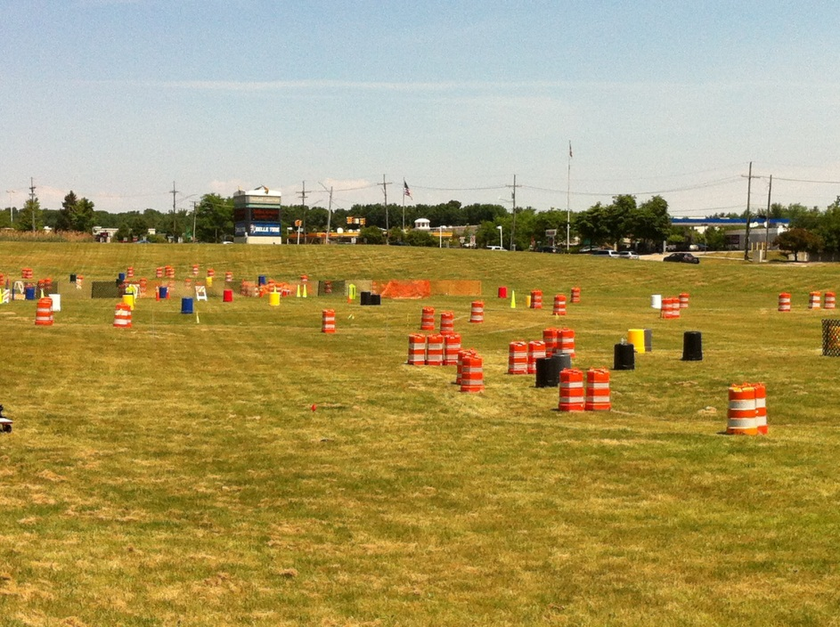
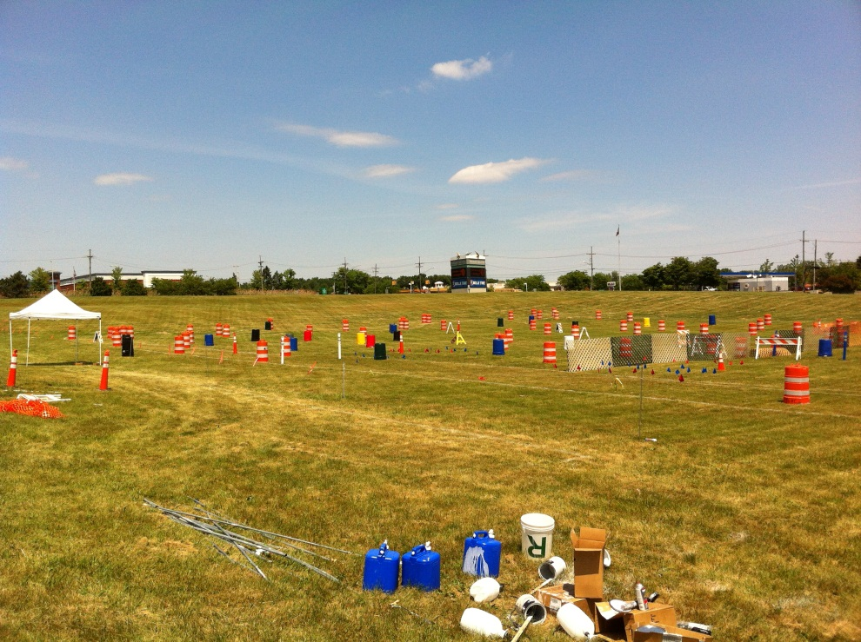
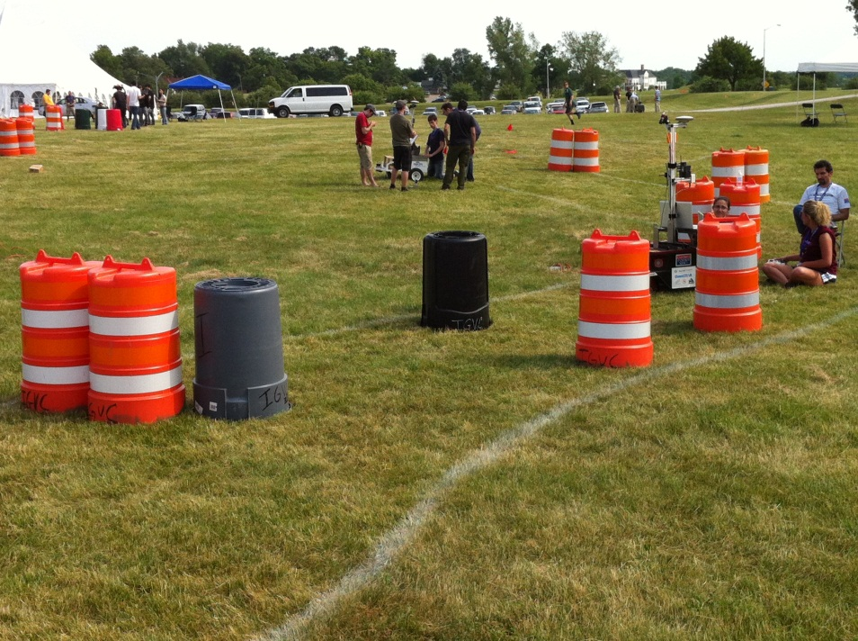
The 2012 IGVC Track

Slide 8
IGVC Team Organization – 2 teams
Hardware Systems
Michael Pauly (lead)
Mechanical Frame
Weight Distribution
Power Distribution
Electronic Wiring
Soldering
Sensor Array
Software Systems
Ruffin White (lead)
PIC Programing
Localization
Image Recognition
A.I. Implementation
GPS Navigation
Testing, testing, and testing

Slide 9
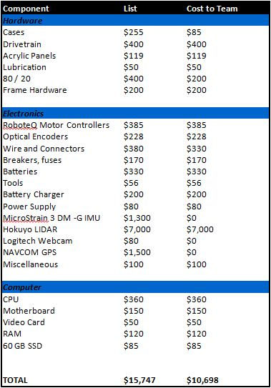
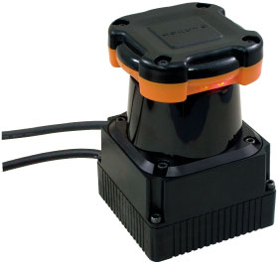
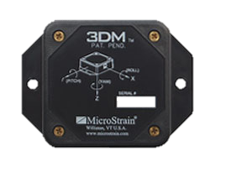
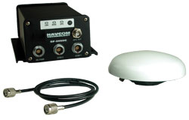
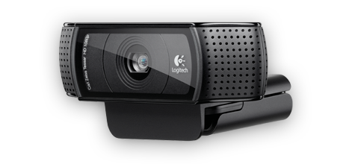
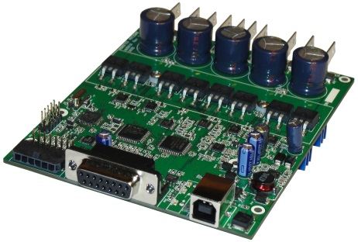

Major components and costs
HOKUYO LIDAR
MicroStrain IMU
NAVCOM GPS
Logitech Webcam
RoboteQ Motor Controller
Intel i5 Core

Slide 10
Software implementation
Start sense loop
Start think loop
Start act loop
Stop sense loop
Handle events
and visualize inputs
Stop act loop
Stop think loop
Graphical
Intuitive building
Fast programming
Robotics friendly environment
Understandable by different engineers
Easy debugging

Slide 11
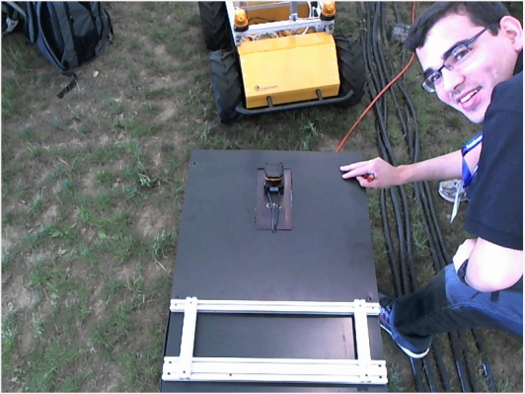
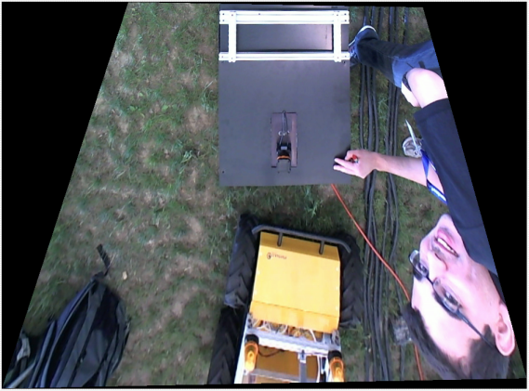
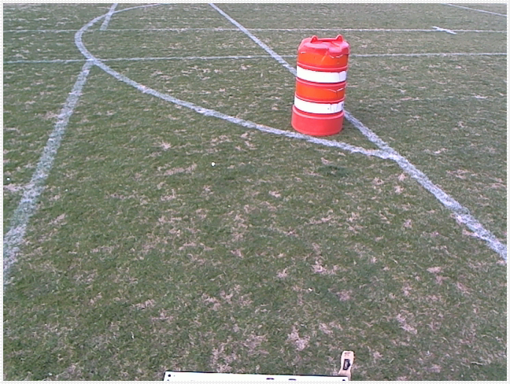
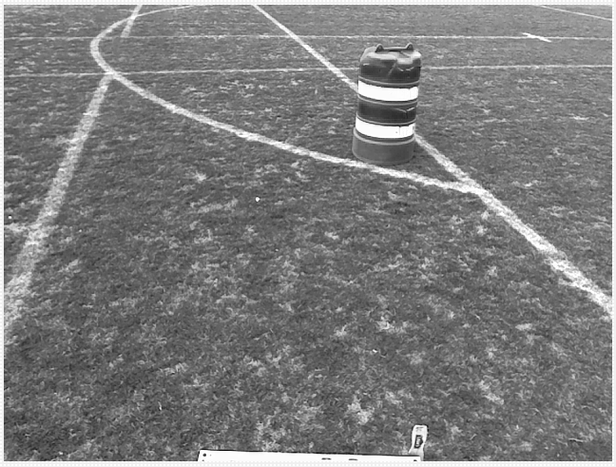
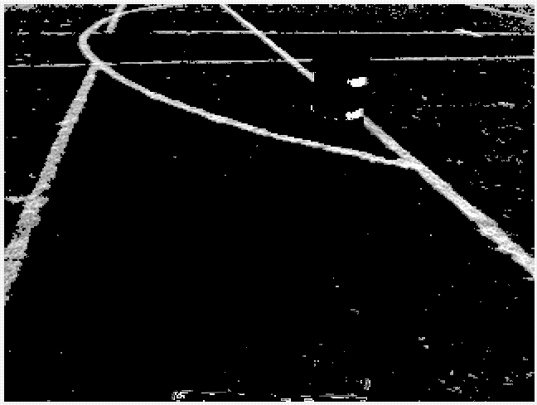


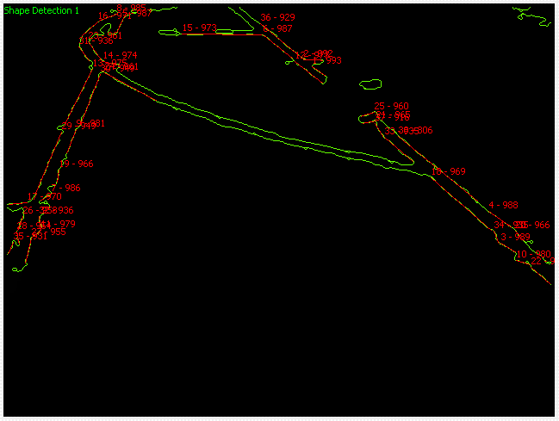
Vision acquisition

Slide 12
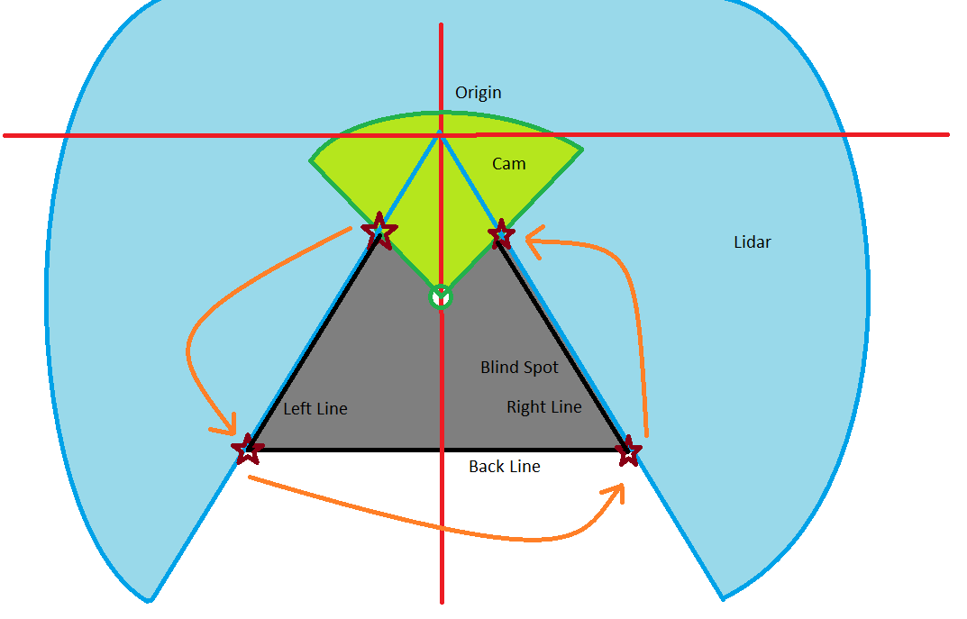
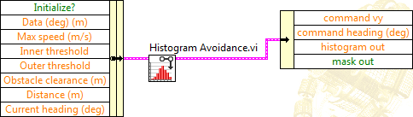
Obstacle detection

Slide 13
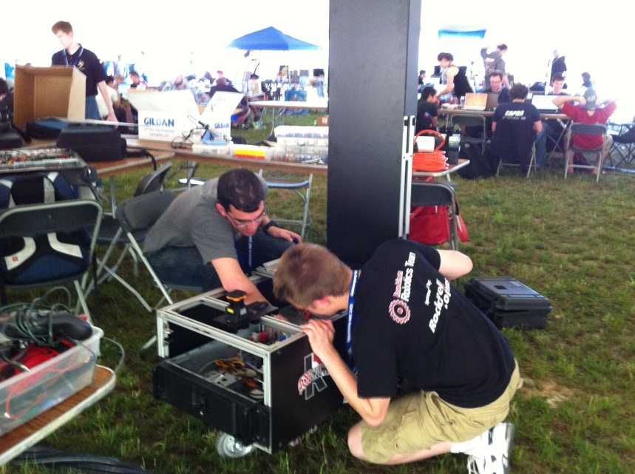
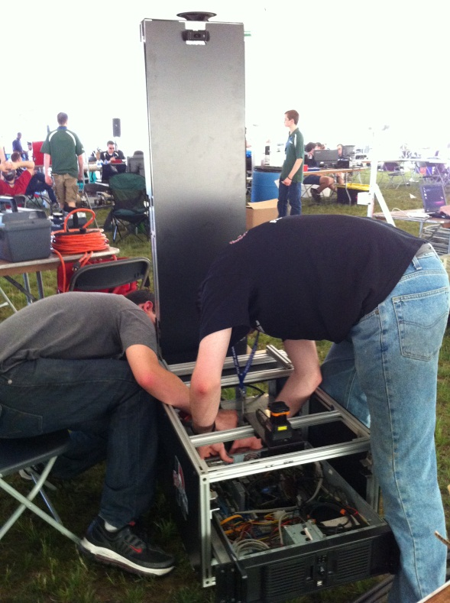
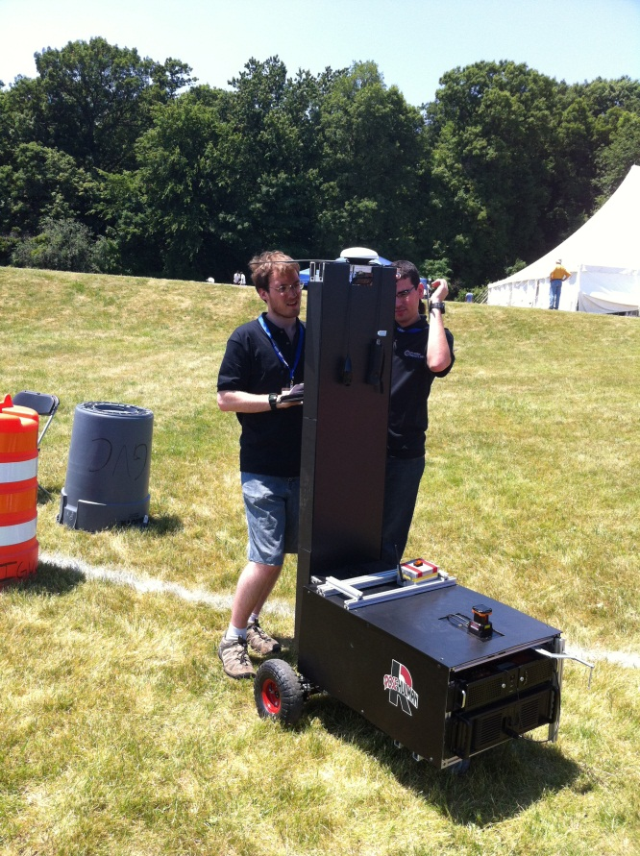
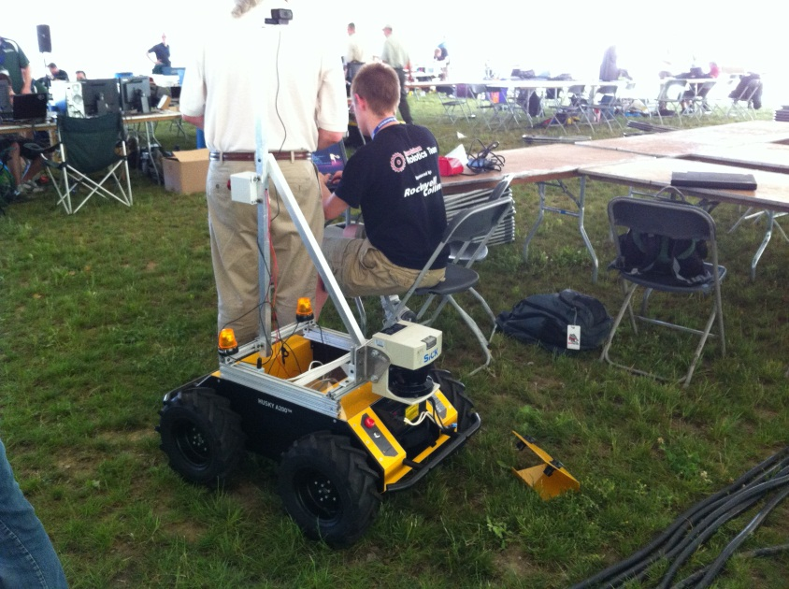
2012 IGVC Pictures

Slide 14
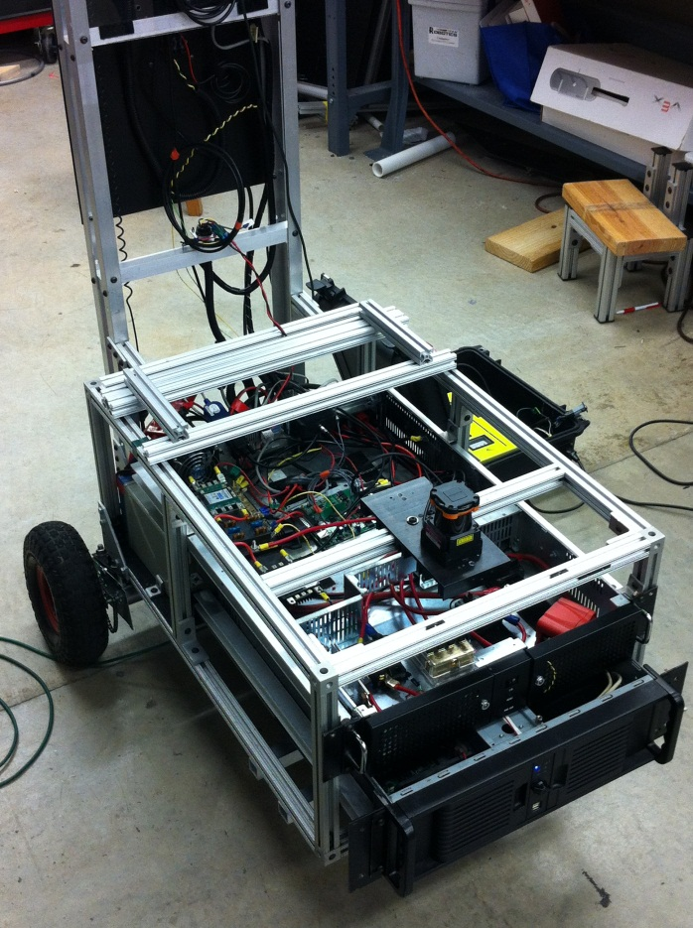
Future plans for IGVC
Keep improving software
Need stronger and reliable frame
Construct new robot design
Change weight distribution
Increase power output

Slide 15
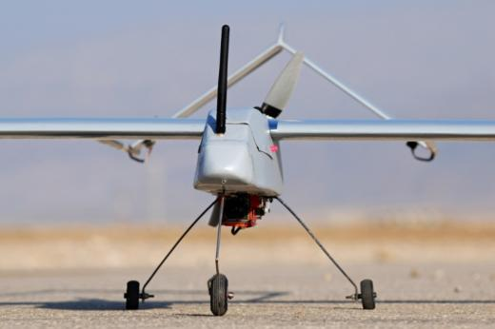
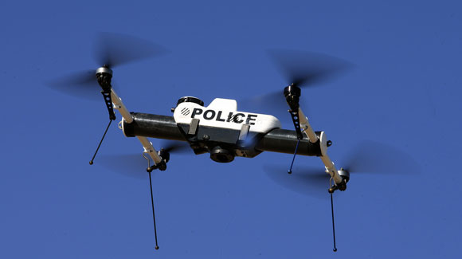
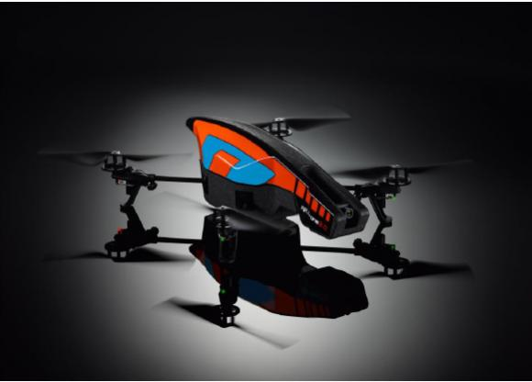
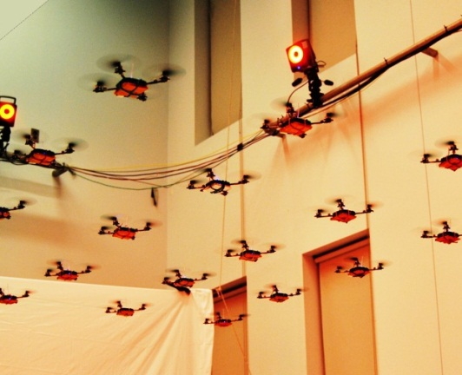
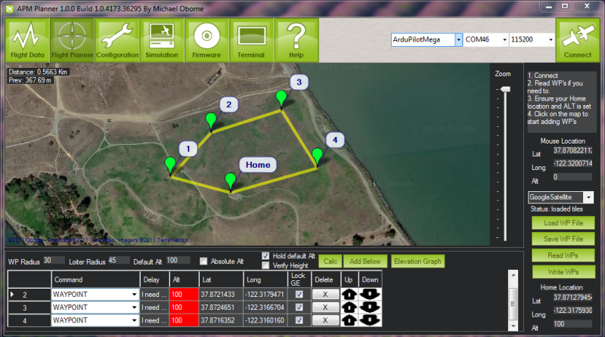
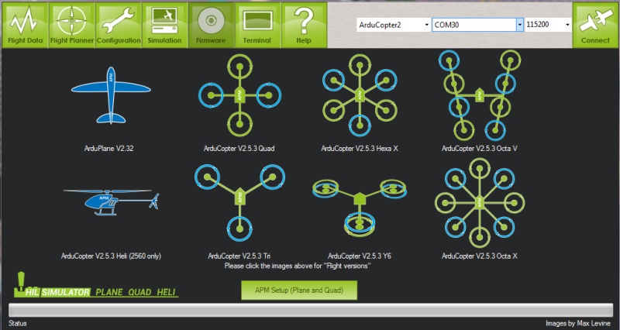
Aerial Robotics
Revive the origins of RHRT
Get students involved in the growing field of aerial robotics
Compete in robotics competitions
Have fun and peruse aerial and robotic hobbies

Slide 16
Plans for the Year
Organize new working space at Branam Innovation Center (B.I.C.)
New students encouraged to take the free Udacity online courses to learn about A.I. implementation, localization, path planning, etc.
All sub-teams will start with new robotics platforms to improve design, resolve problems, and become more competitive.
Allow students to gain a broader hands-on experience on robotics by making the teams slightly more multidisciplinary.
To network with other universities, robotic companies, and the AUVSI organization.
To gain sufficient teamwork and acquire design techniques.
Gain new sponsorships.

Slide 17





Team Acknowledgements
Partner Sponsor
Other Sponsors

